Slide 1
Human-level Control Through Deep Reinforcement Learning
Volodymyr Mnih, Koray Kavukcuoglu, David Silver, Andrei A. Rusu, etc.
Project Group: Qingyuan Feng, Jian Jin, Saad Mahboob, Rui Wang

Slide 2
Acknowledgements
This presentation is partially adopted from the presentations by:
Dong-Kyoung Kye, available at: vi.snu.ac.kr/xe
Jiang Guo, available at: http://ir.hit.edu.cn/~jguo/docs/notes/dqn-atari.pdf

Slide 3
Outline
Motivation & Reinforcement Learning
Model Description
Q-Learning
Q-network
Training Q-network
Innovations of the model
Project outline

Slide 4
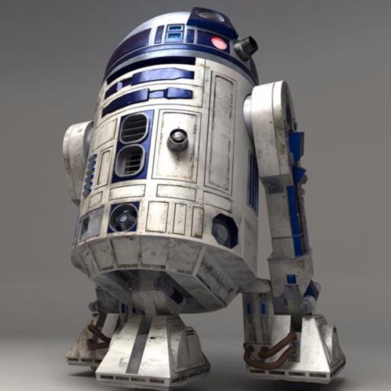
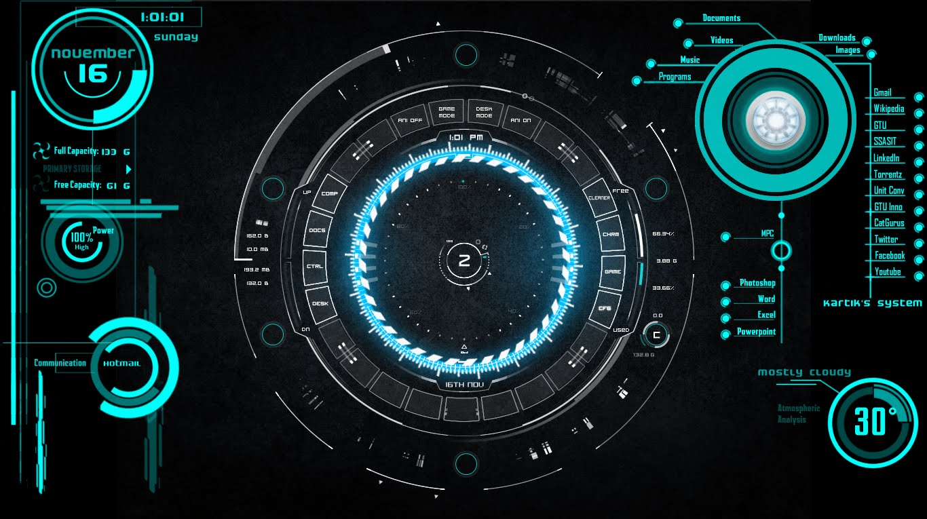
Motivation
Previously the game-playing agents are highly specific to the game
Goal: creating an AI agent capable of playing a wide range of games, one step closer to Jarvis or R2D2
https://www.youtube.com/watch?v=cqXbjyWrdSo
https://twitter.com/r2d2__starwars

Slide 5
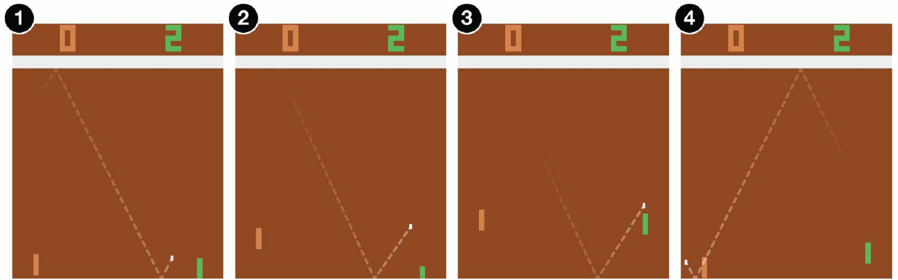
Reinforcement Learning
Want to teach the agent to play games
Supervised learning: let expert players play for 100,000 times
Reinforcement learning is the choice

Slide 6
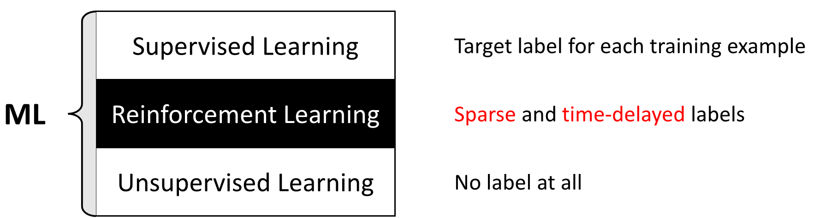
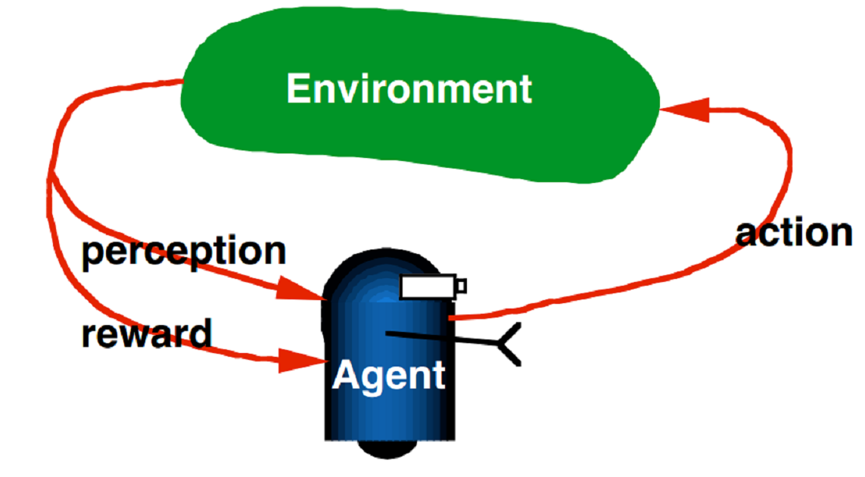
Reinforcement Learning
Categories of ML:
RL mechanism

Slide 7
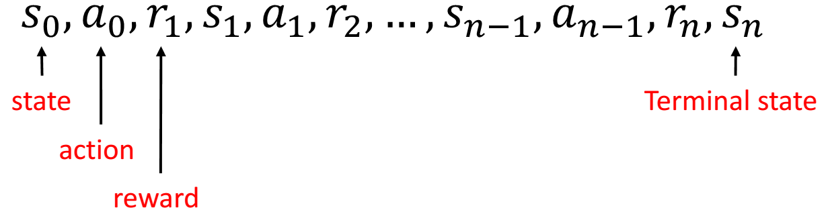
Reinforcement Learning
Markov Decision Process:

Slide 8
Model Description

Slide 9
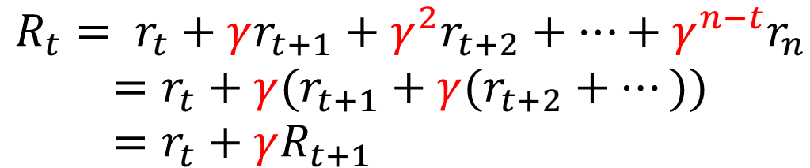
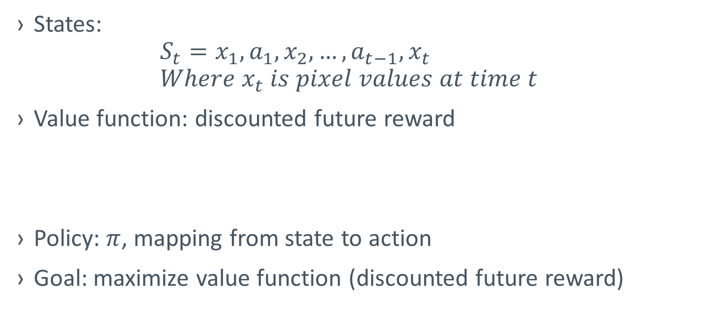
Model components
States: $S_{t}=x_{1},a_{1},x_{2},…,a_{t−1},x_{t}$ $Where x_{t} is pixel values at time t$
Value function: discounted future reward
Policy: $π$, mapping from state to action
Goal: maximize value function (discounted future reward)

Slide 10
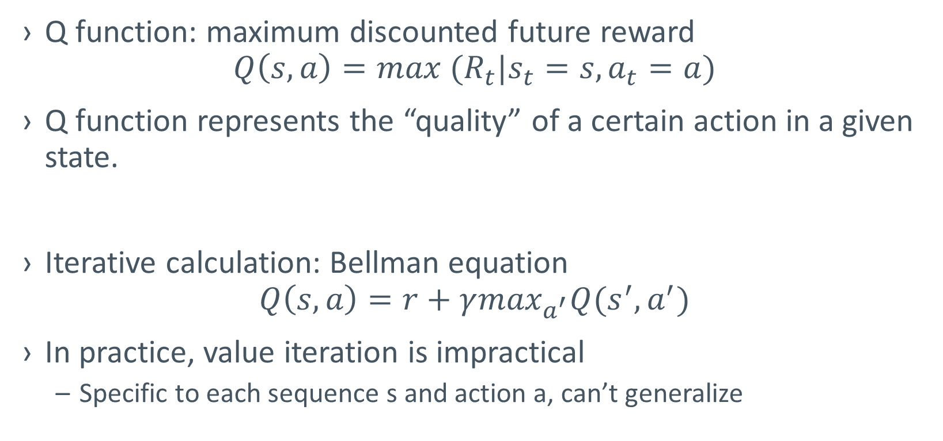
Q-Learning
Q function: maximum discounted future reward $Q\left(s,a\right)=max{ (R}_{t}|s_{t}=s,a_{t}=a)$
Q function represents the “quality” of a certain action in a given state.
Iterative calculation: Bellman equation $Q\left(s,a\right)=r+γ\max_{a^{′}}Q(s^{′},a^{′})$
In practice, value iteration is impractical
Specific to each sequence s and action a, can’t generalize

Slide 11

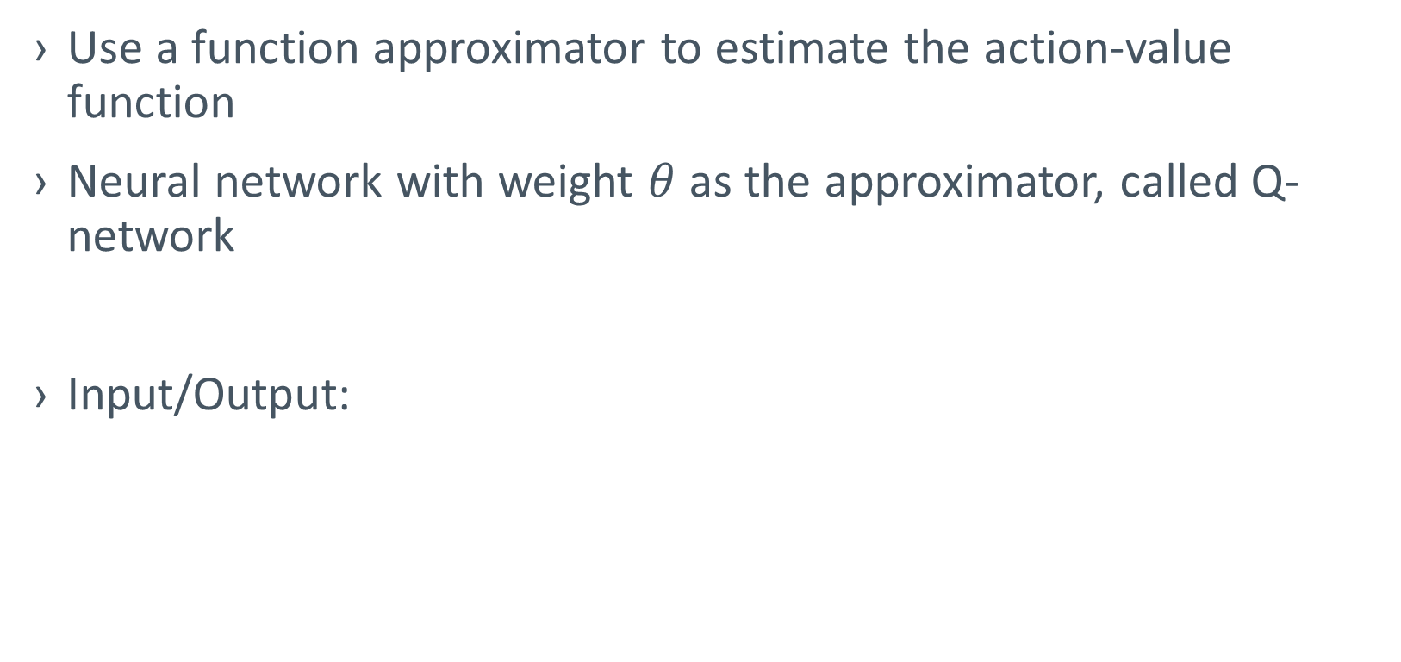
Q-network
Use a function approximator to estimate the action-value function
Neural network with weight $θ$ as the approximator, called Q-network
Input/Output:
Q value of Action 1
Network
Q value of Action 2
State
Q value of Action 3

Slide 12
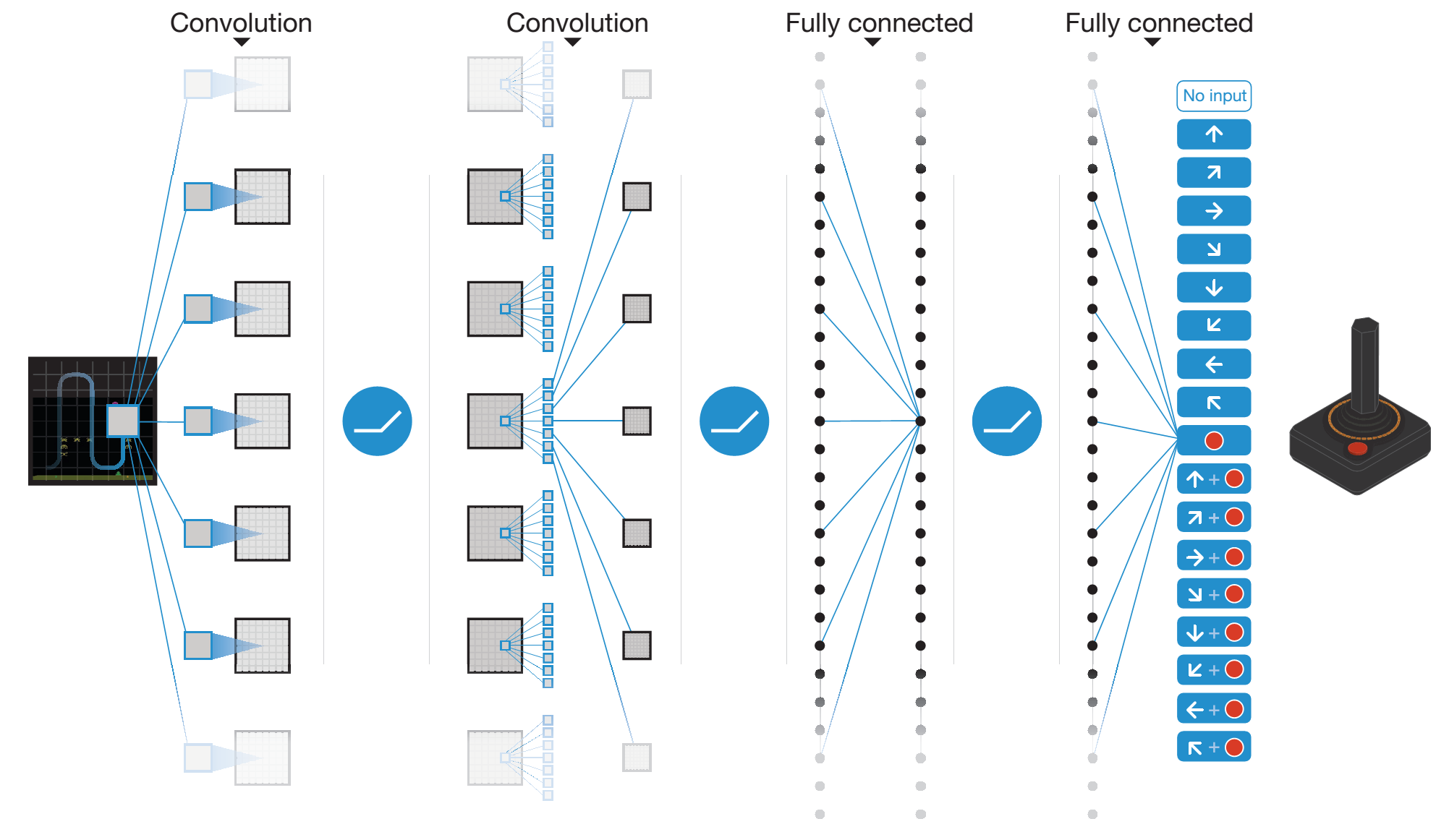
Deep Q-Network

Slide 13
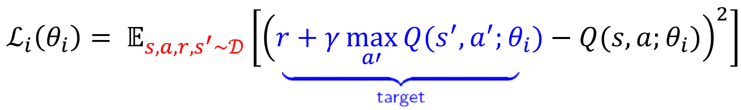

Training Q-Network
Loss function: mean squared error (MSE)
Derivatives w.r.t. the weights:
Using mini-batch SGD

Slide 14
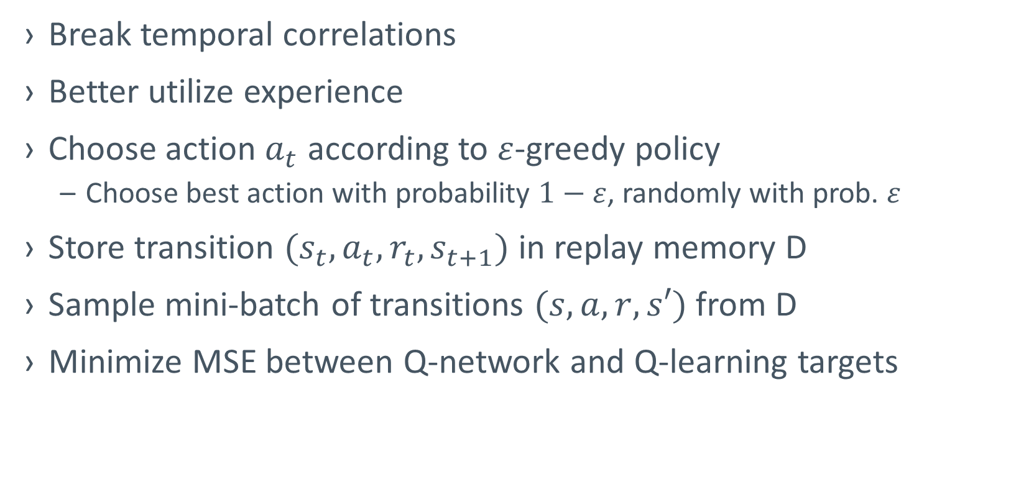
Innovations: Experience Replay
Break temporal correlations
Better utilize experience
Choose action $a_{t}$ according to $ε$-greedy policy
Choose best action with probability $1−ε$, randomly with prob. $ε$
Store transition $(s_{t},a_{t},r_{t},s_{t+1})$ in replay memory D
Sample mini-batch of transitions $(s,a,r,s′)$ from D
Minimize MSE between Q-network and Q-learning targets

Slide 15
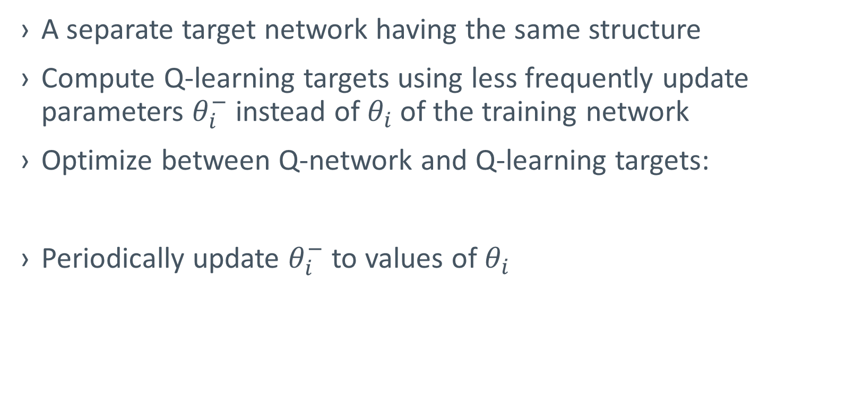
Innovations: separate target network
A separate target network having the same structure
Compute Q-learning targets using less frequently update parameters $θ_{i}^{−}$ instead of $θ_{i}$ of the training network
Optimize between Q-network and Q-learning targets:
Periodically update $θ_{i}^{−}$ to values of $θ_{i}$

Slide 16
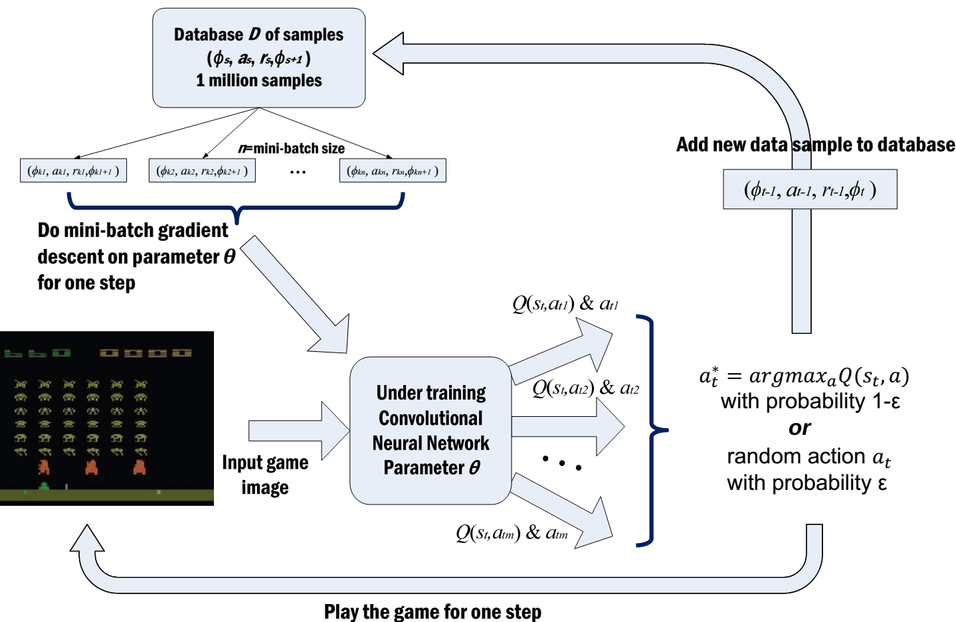
Complete workflow

Slide 17
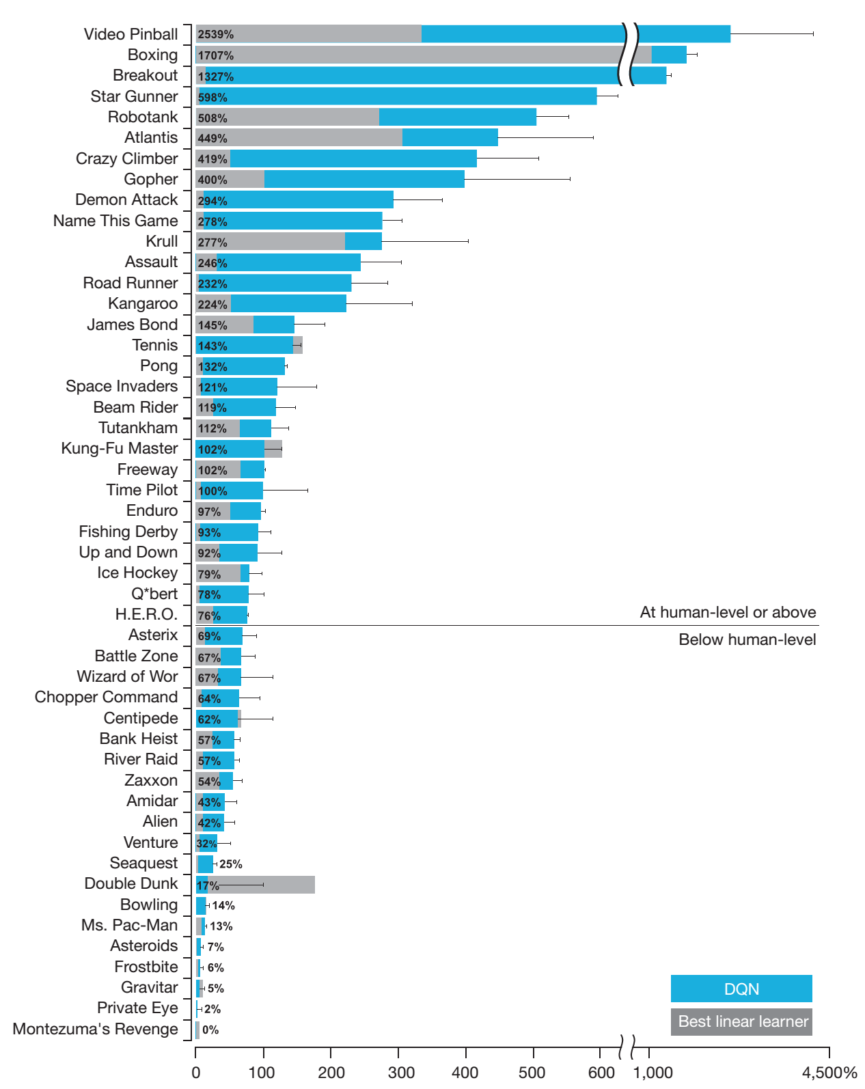
Results

Slide 18
Project Description

Slide 19
Title and Content Layout with Chart

Slide 20
Two Content Layout with Table
 | Group A | Group B
Class 1 | 82 | 95
Class 2 | 76 | 88
Class 3 | 84 | 90
First bullet point here
Second bullet point here
Third bullet point here

Slide 21
Two Content Layout with Table
A
Task 1
Task 2
B
Task 1
Task 2
C
Task 1
First bullet point here
Second bullet point here
Third bullet point here

